Slide 1
ENSE 470, Milestone 5
ByteThis Software
Taylor Petrychyn, Alwin Baby, and Konstantin Kharitonov
February 28, 2018

Slide 2
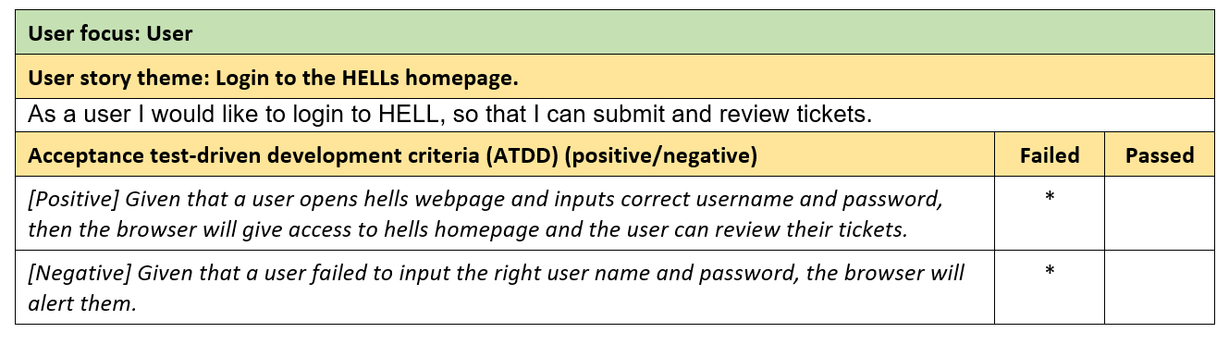
Acceptance Test-Driven Development (ATDD) - Users

Slide 3
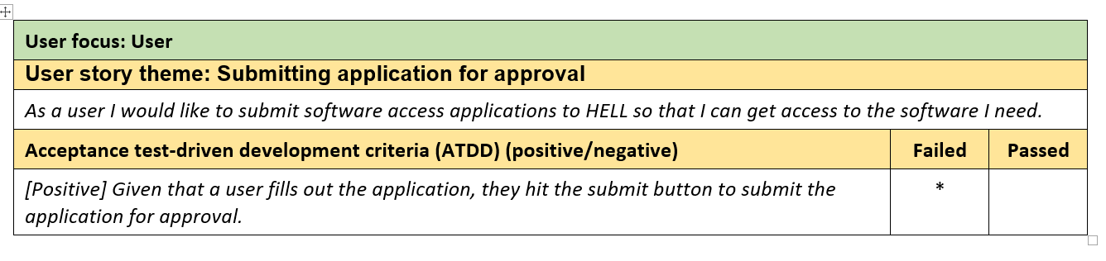
Acceptance Test-Driven Development (ATDD) - Users

Slide 4
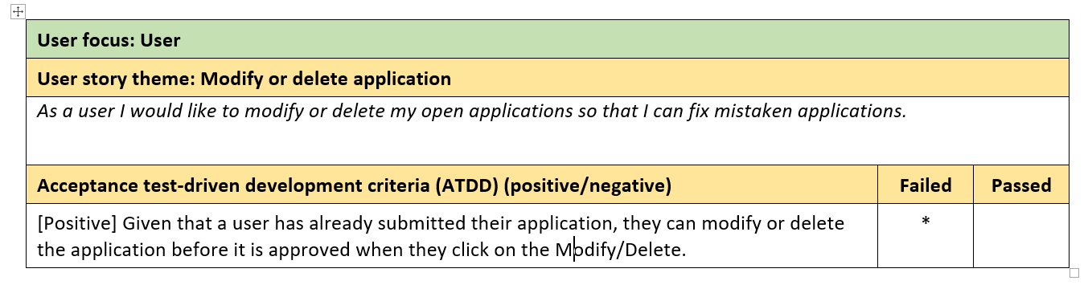
Acceptance Test-Driven Development (ATDD) - Users

Slide 5
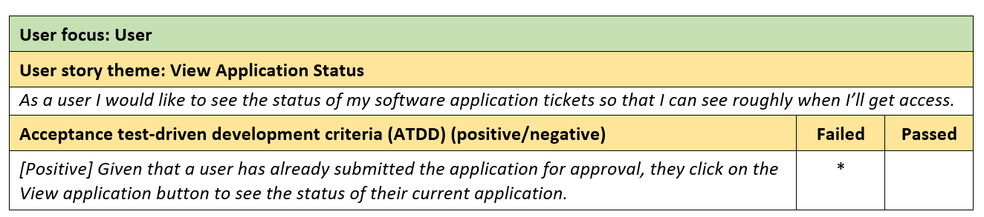
Acceptance Test-Driven Development (ATDD) - Users

Slide 6
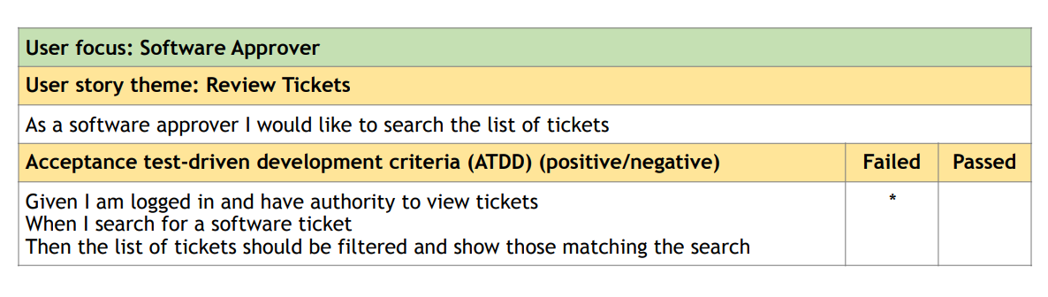
Acceptance Test-Driven Development (ATDD) - Approvers

Slide 7
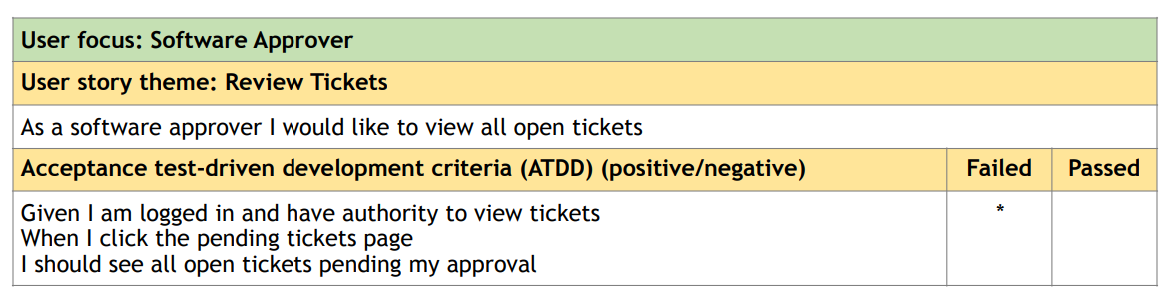
Acceptance Test-Driven Development (ATDD) - Approvers

Slide 8
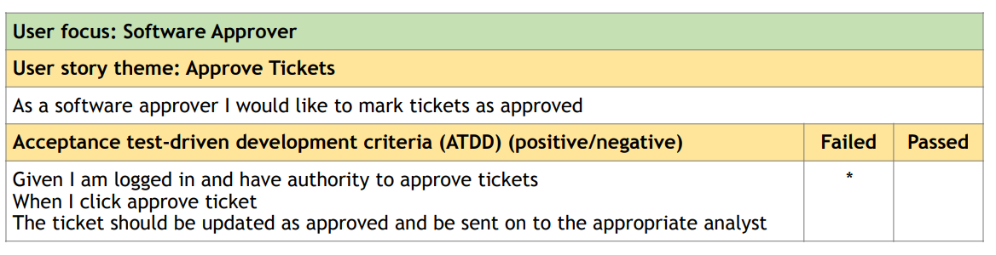
Acceptance Test-Driven Development (ATDD) - Approvers

Slide 9
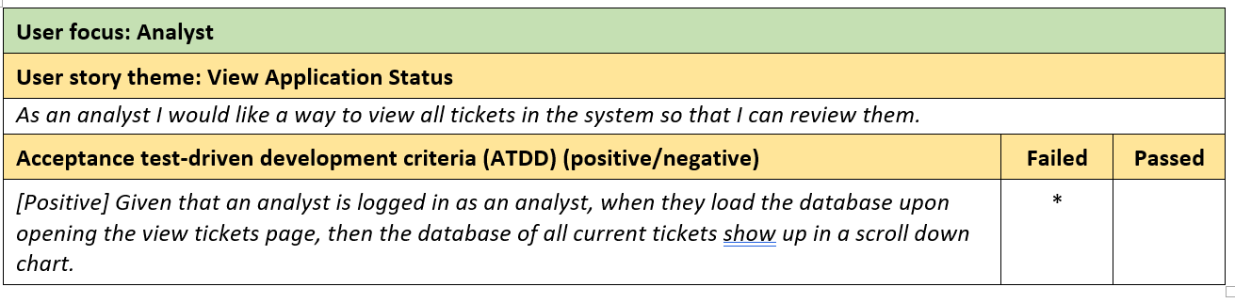
Acceptance Test-Driven Development (ATDD) - Analyst

Slide 10
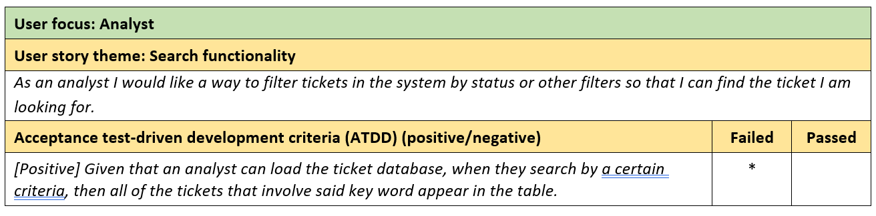
Acceptance Test-Driven Development (ATDD) - Analyst

Slide 11
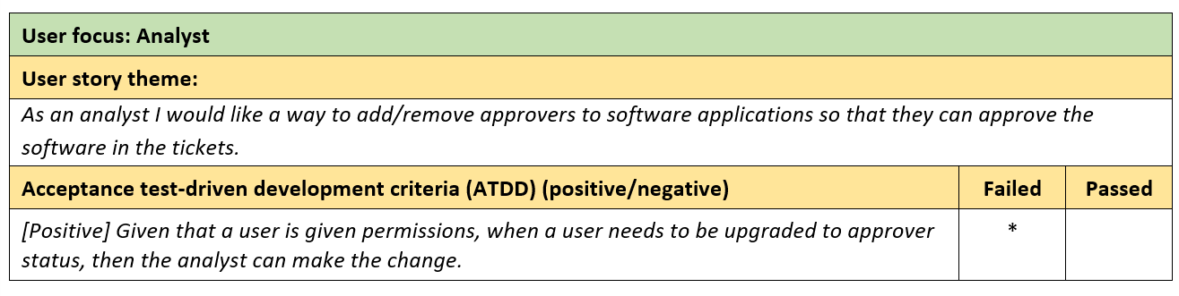
Acceptance Test-Driven Development (ATDD) - Analyst

Slide 12
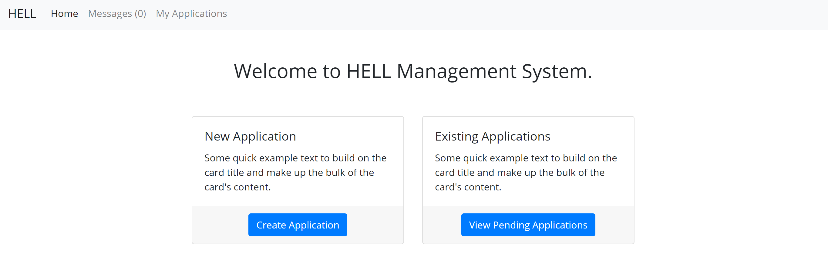
App Preview

Slide 13
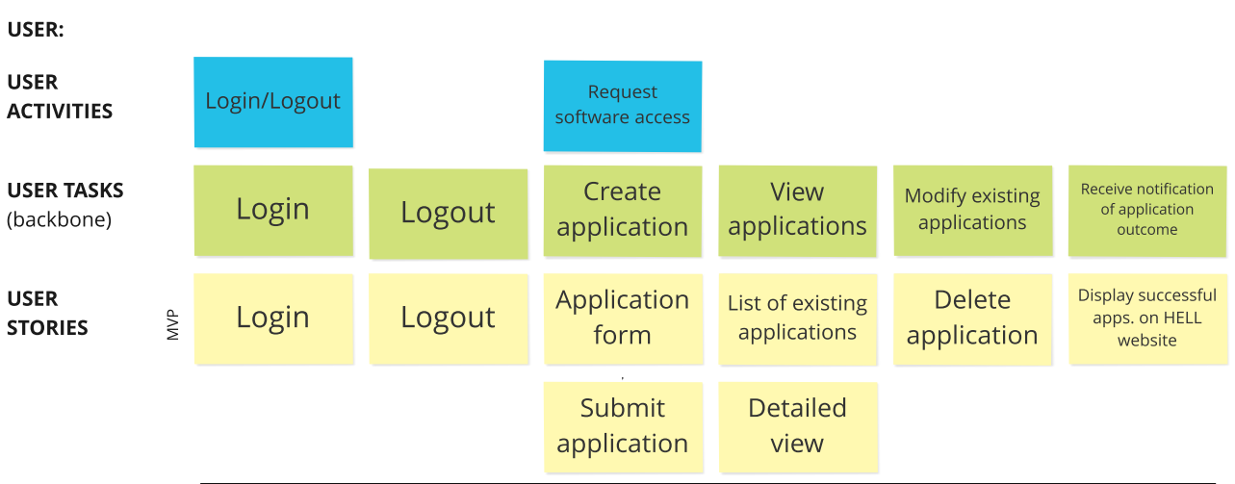
Review – USM(User)

Slide 14
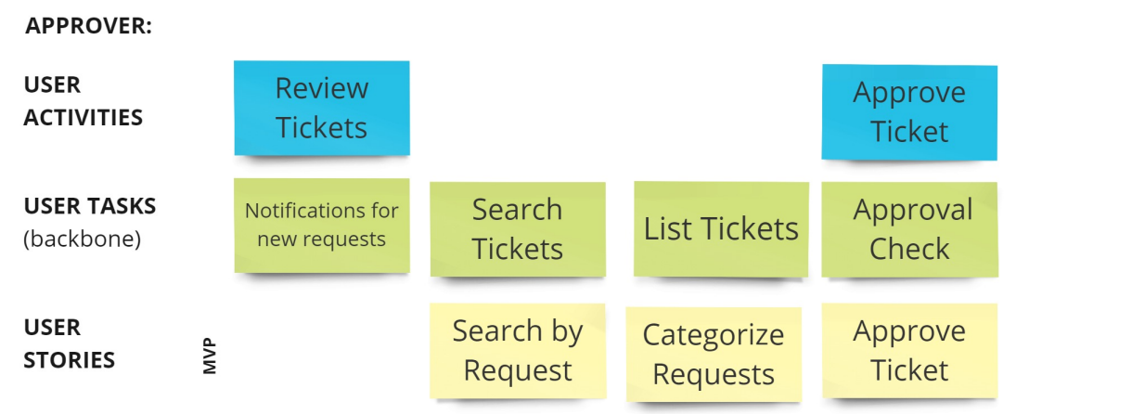
Review – USM(Approver)

Slide 15
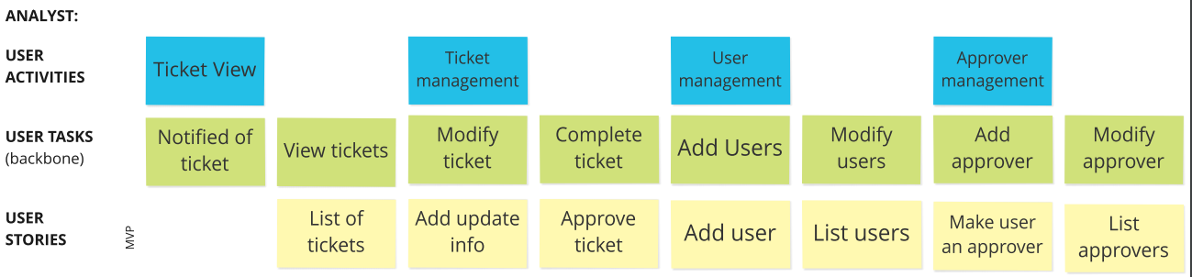
Review – USM(Analyst)

Slide 16
Changes & Misc.
Changes to the procedure
  Using PreSQL and npm to host the app locally for changes
  Actual CSS designs might come after release of MVP

Slide 17
Group reflection
How did you feel about this milestone? What did you like about it? What did you dislike?
  Fun, but slightly tedious
  Informative to building the application
What did you learn about yourself as you collaborated and worked through this milestone?
  Need to learn more about using Node.js
How will you use what you have learned going forward?
  Future programming with this project and for future post university projects
What “stuff & things” related to this milestone would you want help with?
  More knowledge about ATDD

